Slide 1
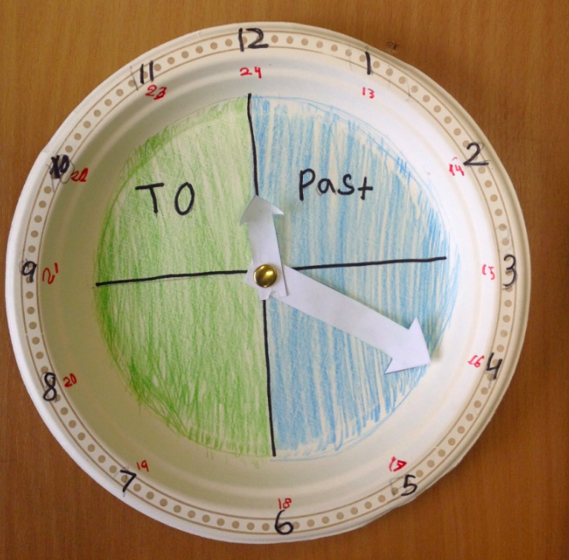
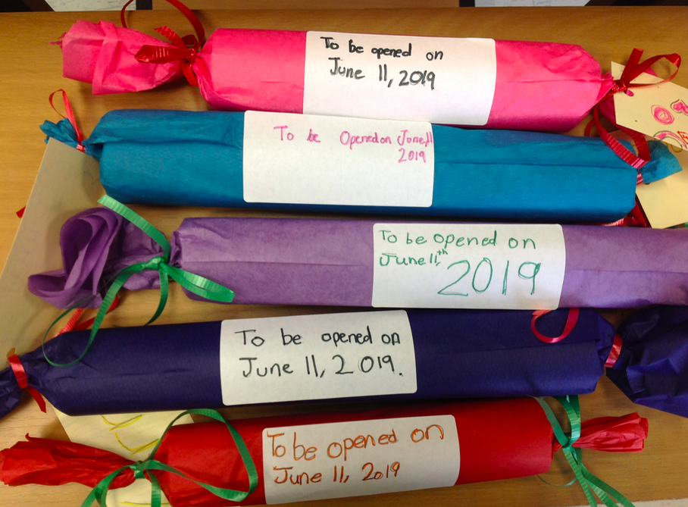
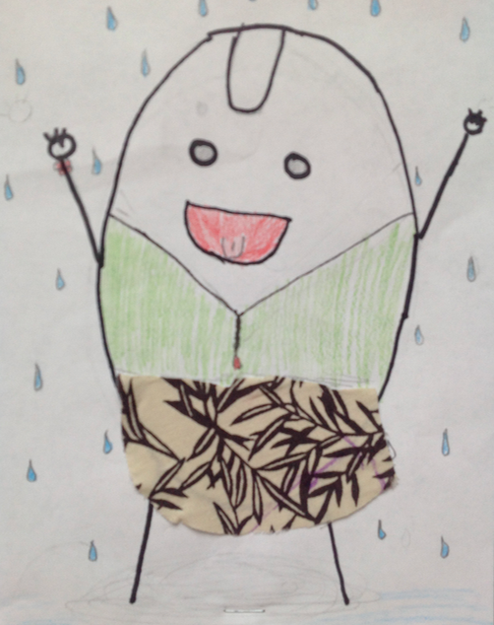
Welcome!
Information about the 2018-2019 School Year!

Slide 2
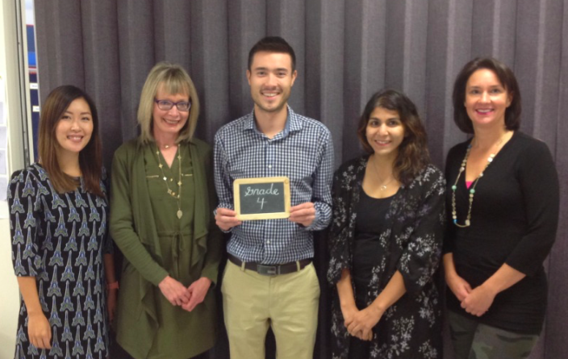
About Our Team:
Mireille Vroom - 4A
Laurel Mason - 4B
Shariffa Mawani - 4C
Cindy Yong - 4D
Reggie McClellan - 4/5

Slide 3
Communication
Classroom Blog: daily Agenda messages and weekly snapshot of our learning
Email: chyong@cbe.ab.ca
Phone: (403) 777-6410
School Website

Slide 4
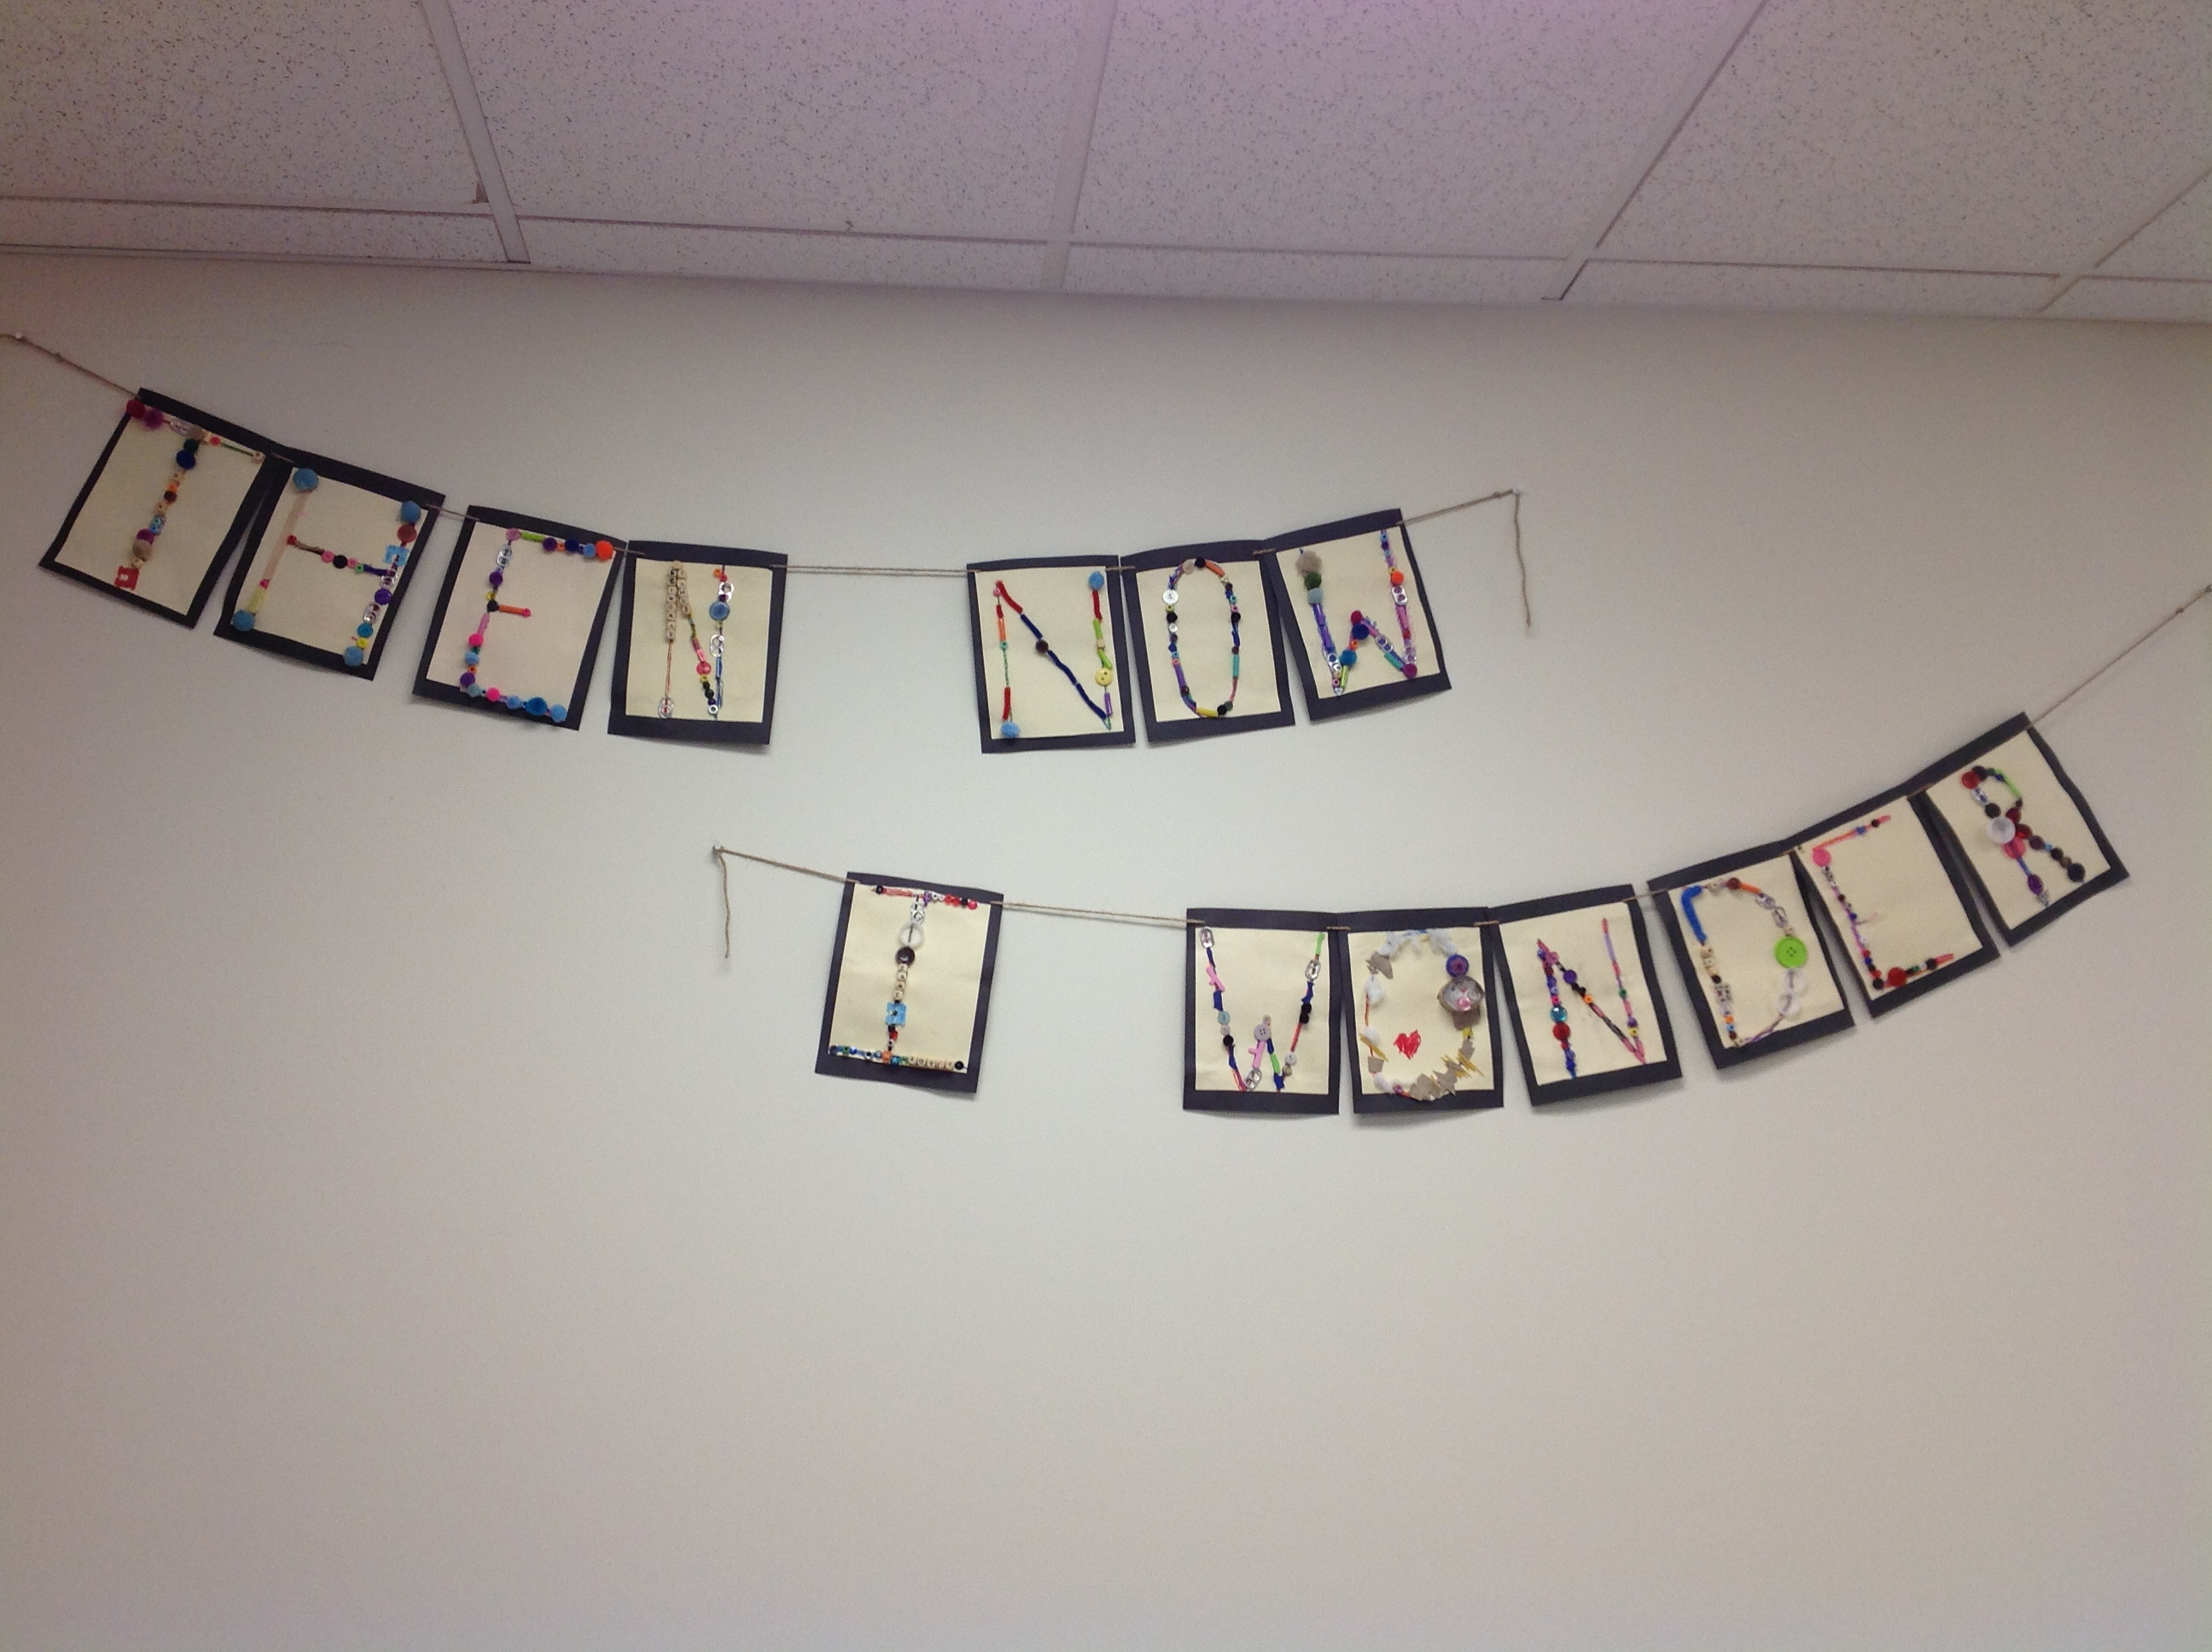
Classroom Theme
Then, now, I wonder?

Slide 5
Home Learning:
Daily home reading – 20 minutes each night
Unfinished classroom work
Home learning activities - occasional math problems, “bring in an artifact that is…”
Home Projects: 1-2 for this school year

Slide 6
Gym, Music and Buddies
Gym with Mike Janzic
Days 1, 2, 4
Daily Physical Activity (D.P.A.) on days with no gym time scheduled
Students should wear running shoes in the gym
Music with Kristen Smith
Days 3 and 5
Buddies with PM kindergarten students

Slide 7
Library Learning Commons
Students are welcome to select books from the Library Learning Commons
They are encouraged to choose just right books for their individual reading level

Slide 8
Classroom Expectations
Students are encouraged and expected to treat each other and school staff in a respectful manner.
Class Meetings will be held regularly to provide an opportunity for students to share compliments and concerns in a safe environment.
Students are encouraged to solve disagreements with greater independence in Grade 4.
Situations and students are unique however so if you need support with a situation taking place at school please let me know. I'm happy to help out if there is an immediate concern or an ongoing issue.

Slide 9
Absences
If your child will be away from school for a period of time or is leaving during the day for an appointment, a note is greatly appreciated so that I can plan how to provide them with opportunities to learn what was missed or send notices and work home.
Notes:
Novel read alouds, Math activities

Slide 10
Program of Studies
For additional information and resources connected to the Program of Studies, please refer to education.alberta.ca.
The Program of Studies can also be found online at:
https://www.learnalberta.ca/content/mychildslearning/
https://education.alberta.ca/teachers/program/

Slide 11
Reporting
Student Led Conferences: November 22 and 23, 2018
Report cards: December 20, 2018
Student Led Conferences: March 21 and 22, 2019
Report Cards: June 26, 2019

Slide 12
Field Trips
Shepard Landfill - November 13 or 14, 2018
Living Soil, Worms at Work - October 19, 2018
Wheels in Motion - March 4 or 5, 2019
Glenbow Ranch - May 7 or 8, 2019

Slide 13
Please Consider Volunteering!
Hawkwood School Council, with its fundraising partner Friends of Hawkwood School Society, organize social events and fundraisers throughout the school year.
Without volunteers, many of the activities that you and your children look forward to may not be able to continue including Fun Lunches, Dances, and Movie Nights.
As well as being lots of fun, these events also raise money that allows School Council to provide additional resources for the whole school like iPads, laptops, field trips, and special resources.
We are very willing to work with you to find the right fit. Be it a couple of hours for a special event or on a more regular basis for programs such as Fun Lunches we have a need for you!
If you’re interested, please fill out a volunteer form or email hawkwoodsc@gmail.com and we will get in touch with you!

Slide 14
Thank you!
Thank you so much for coming!
Please email me with any further
comments or questions!
Cindy Yong
chyong@cbe.ab.ca

